Slide 1

Is Aviation Right for Us?
Google Images
A Data-Driven Decision Guide
Presented by: Achieng Otieno
Date: June 30, 2025

Slide 2
Overview – Our Mission: Safer Skies
Goal
Why this matters
Context
What I explored
Our goal is to equip leadership with a clear understanding of inherent risks and operational realities to inform a strategic decision regarding potential market entry or investment.
Informed Investment:
Risk Mitigation
Strategic Positioning
Reputation & Compliance
Historical air accident data to pinpoint critical risk factors, evaluate operational challenges, and identify areas requiring significant strategic consideration for any new entrant.

Slide 3
Business Understanding – The Aviation Frontier: Opportunity Meets Complexity
Business Questions
Strategic Question
Project Goal
What are the safety implications of different aircraft types, and how might this influence fleet selection?
How does accident severity (e.g., aircraft damage leading to fatalities) impact the operational and financial landscape for a new player?
Can historical data guide us towards safer operational models or aircraft acquisitions within the industry?
The aviation industry presents significant opportunities, but also unique operational challenges and inherent risks. Before committing resources, we need a clear, objective assessment of its safety environment.
Provide actionable insights derived from accident data, empowering our strategic decision-making on whether and how to best position our entry into the aviation industry.

Slide 4
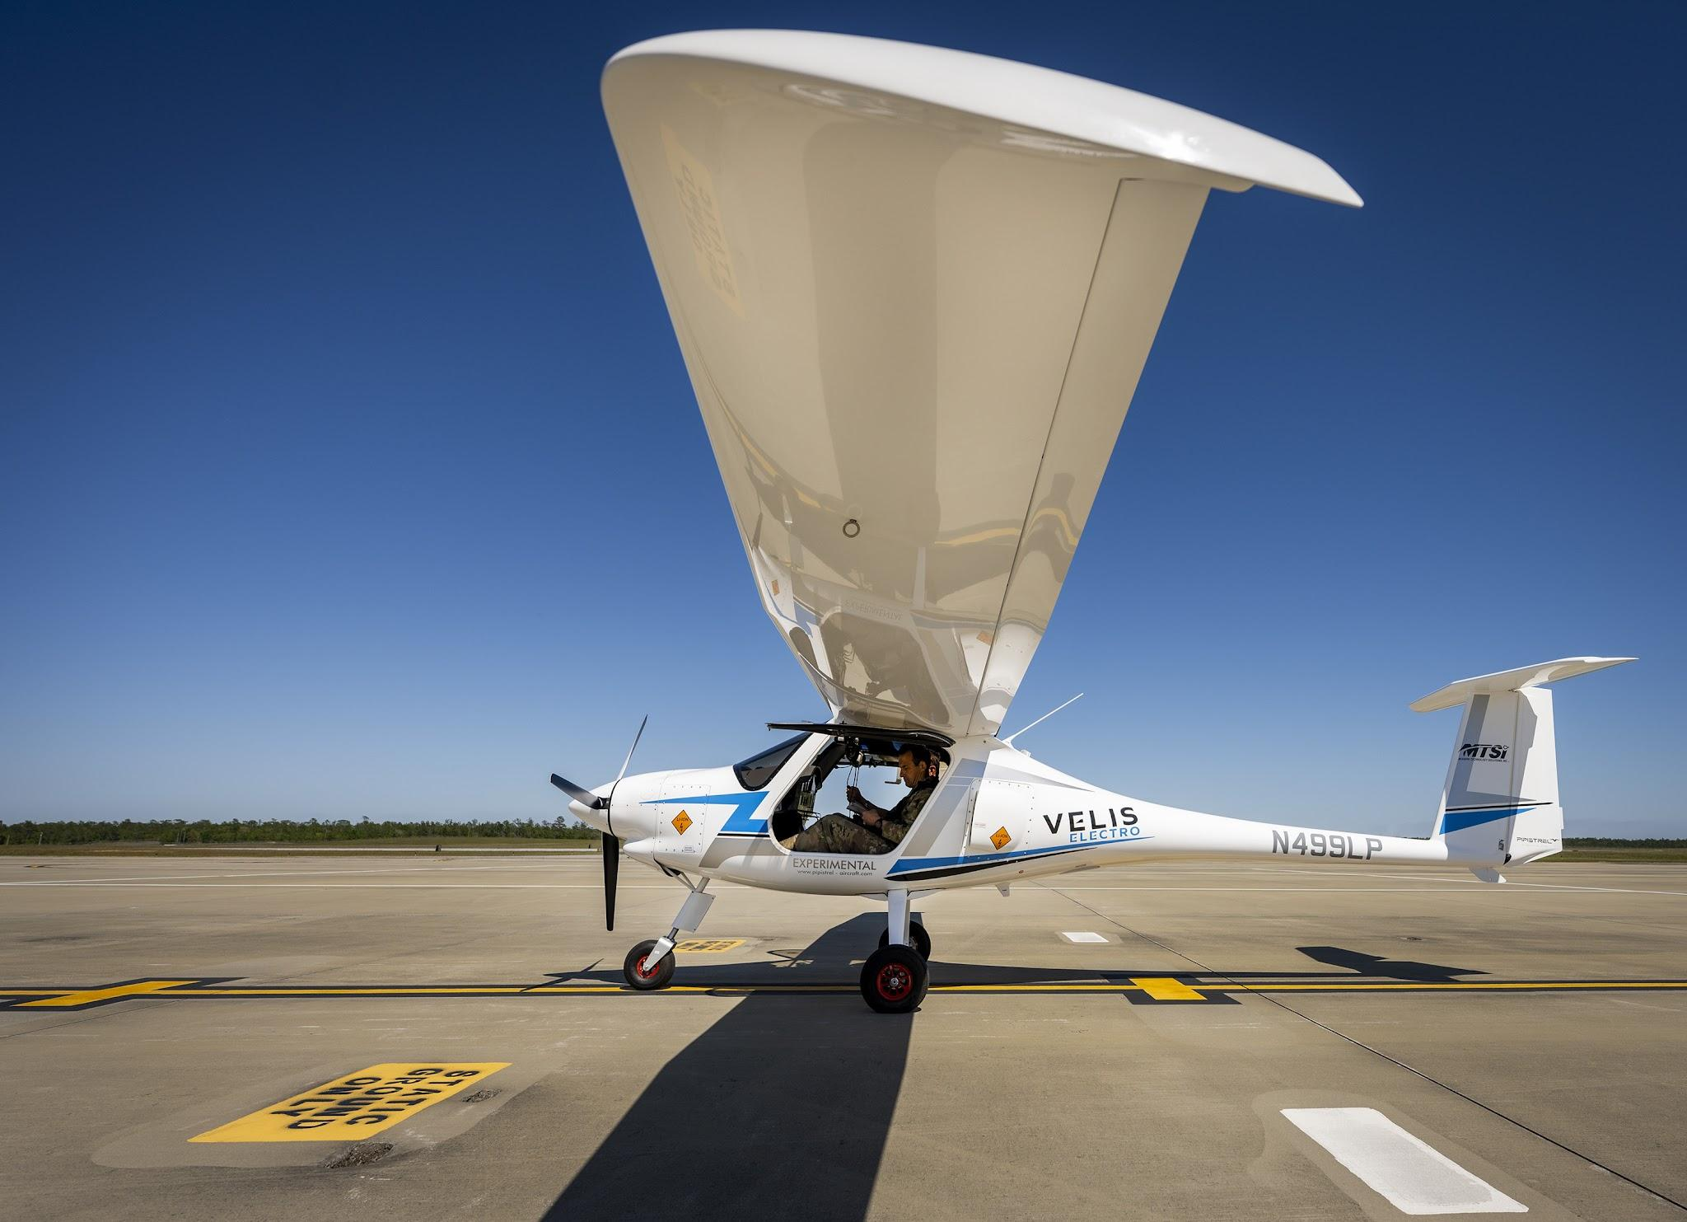
Analytical Compass
The Data Source: A comprehensive dataset of historical air accident incidents (1948 -2022) provided by the NTSB. This rich source provides details essential for understanding the operational realities and inherent risks within the aviation sector.
Key Data Points Utilized:
Accident Phase: (e.g., Landing, Takeoff, Cruise) Purpose of Flight: (e.g., Personal, Instructional, Commercial)
Aircraft Category: (e.g., Airplane, Helicopter)
Aircraft Damage Level: (e.g., Minor, Substantial, Destroyed)
Fatalities: Number of lives lost
Aircraft Model & Make: Identification of specific aircrafts.
Data Understanding
Google Images

Slide 5
Analytical Approach
Python, a powerful programming language, was used along with these specialized libraries:
Pandas & Numpy: For efficiently organizing and manipulating large datasets, acting like an advanced spreadsheet.
Matplotlib & Seaborn: For creating clear and informative visualizations, transforming raw numbers into understandable pictures of risk and trends.
This process, known as Exploratory Data Analysis (EDA), systematically uncovered patterns, identified potential pitfalls, and highlighted areas requiring deep consideration before market entry.
Exploratory Data Analysis - EDA

Slide 6
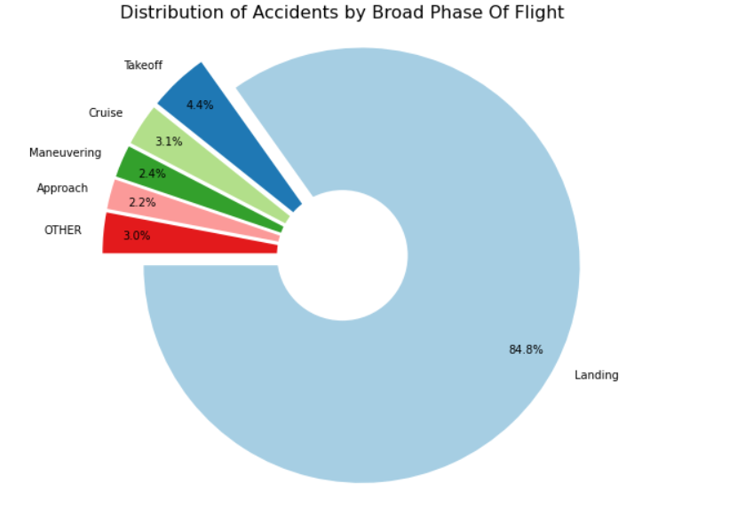
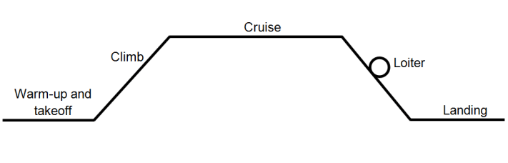
Data Analysis – Identifying Inherent Risks
Landing Phase – The Most Consistent Risk Point for Any Operation
Insight: landing phase of flight accounts for the highest number of recorded air accidents across the industry.
For any new entrant, this highlights a fundamental, high-risk operational segment that demands rigorous planning, advanced pilot training, and robust equipment maintenance.
Google Images

Slide 7
Market Segments and Their Risk Profiles
PURPOSE | RECORDS
Personal | 21266
Instructional | 3740
Ariel Application | 1386
Unknown | 1119
Business | 915
Positioning | 515
Other work use | 334
Aerial Observation | 313
Flight Test | 266
Ferry | 195
Personal & Instructional Flights – A Segment with Elevated Accident Incidence
Insight:
Majority of recorded accidents occur within flights conducted for personal and instructional purposes.
Should the company consider entering these segments, we would face a higher inherent accident frequency, potentially linked to diverse pilot experience levels, less standardized operations, or varied flight environments.

Slide 8
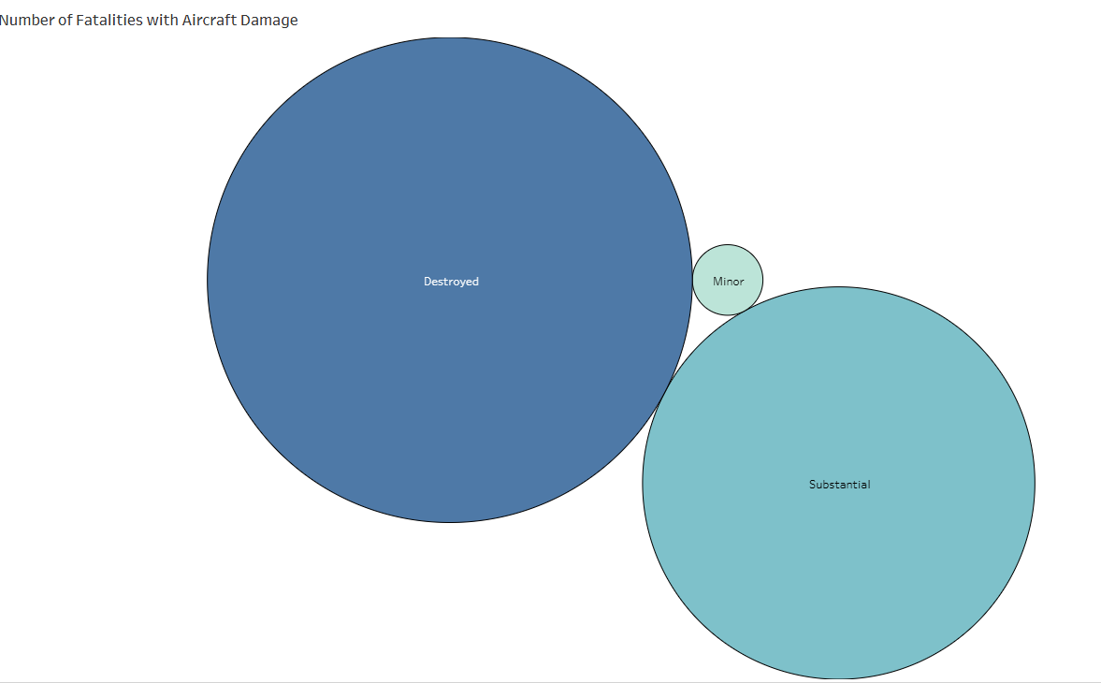
Asset Loss and Human Impact
Catastrophic Damage Drives Fatalities; Airplanes Show Higher Fatality Rates
Insight: While "Substantial Damage" is the most common outcome, a significantly higher number of fatalities occur when aircraft are classified as "Destroyed."
Furthermore, airplanes exhibit a 69.5% fatality rate, slightly higher than helicopters at 63.0%, a factor to consider when evaluating fleet acquisition and operational risk.

Slide 9
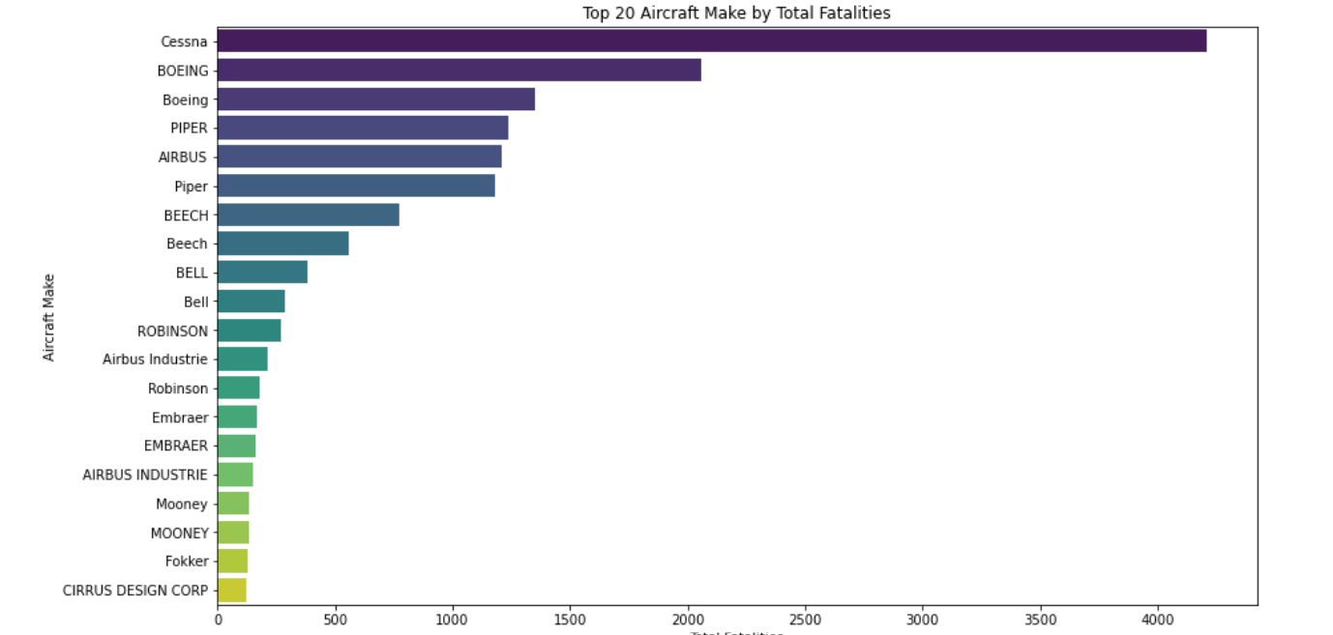
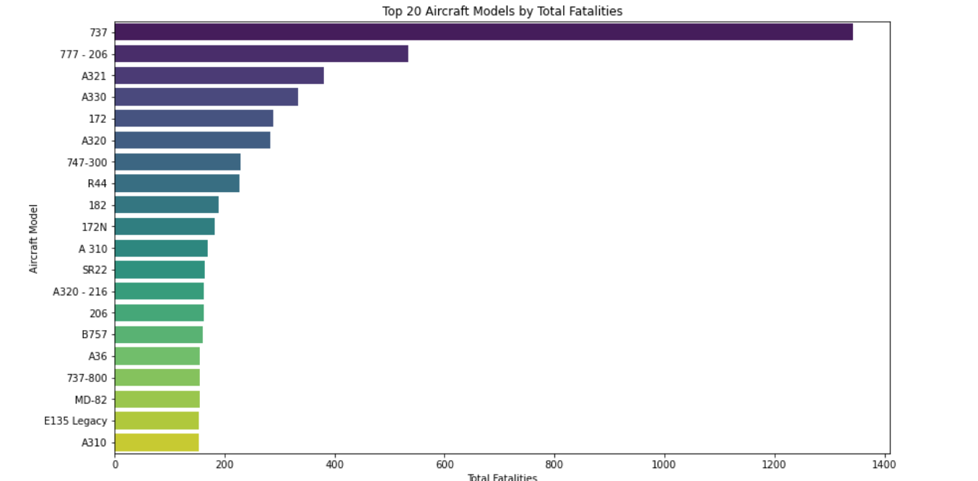
Identifying Safer Operational Makes/Models
Airbus A310 Aircraft Model has demonstrated the lowest number of recorded fatalities in our dataset, indicating a potentially robust design or operational safety record.
Cirrus Design Corp and Fokker Makes also show the lowest fatality counts

Slide 10
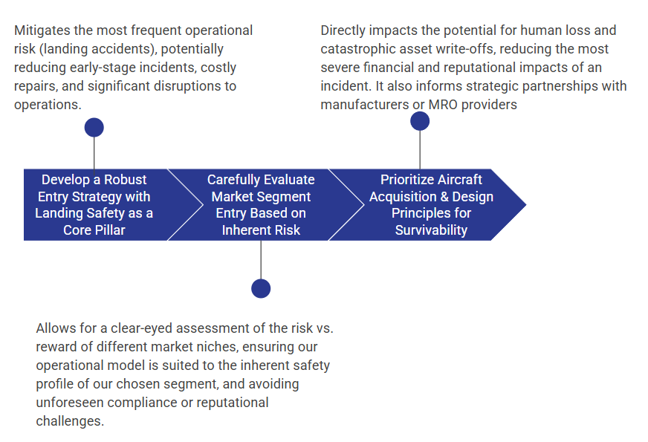
Recommendations – Strategic Pathways for Aviation Entry

Slide 11
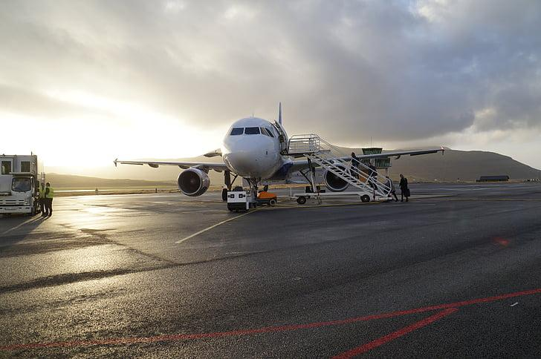
Questions?
Google Images
Achieng Otieno
LinkedIn Profile: www.linkedin.com/in/achieng-otieno

